Slide 1
Dictionaries, Tuples, Sets
Session Six
Notes:
Welcome to our sixth session! This semester is flying by. As always today we will be covering a handful of topics: dictionaries, tuples, sets, malware, and an intro to VirusTotal. We are really in it now y’all between tackling complex programming concepts and substantive security material.

Slide 2
Reminders
Due Today
Due Next Week
Homework
Quiz
Homework from this session
Quiz on this session’s content
Notes:
Today we have a homework due and a quiz.

Slide 3
Reminders
Due Today
Due Next Week
Homework from Session Five
Quiz on Session Five Content
Homework from this session
Quiz on this session’s content
Notes:
Next week we have our second to last homework due before we get into the projects. I highlight this because we are working our way through the basics and are quite near the point where the homework will move into purely the applied style of programming questions.

Slide 4
Agenda / Topics
1. Start of class & quiz
2. Dictionaries
3. JSON
4. Break
5. Security Topic
6. Overflow / Q&A / Dismissal
6:30 - 7:00
7:00 - 7:45
7:45 - 8:00
8:00 - 8:15
8:15 - 8:45
8:45 - 9:00
Notes:
Today we’ll have a q&a to answer any last-minute burning questions from last week and then we’ll be doing the practice quiz. After that, we’ll start the lecture. We’ll cover a handful of topics with a break at 8 pm and we’ll wrap the class up before 9 pm.

Slide 5
Q&A
?
Notes:
Any last-minute questions before the quiz?

Slide 6

Quiz
Access the quiz here:
https://forms.gle/REkqs513nTc7dR7Z6
Screenshot before submitting & don’t refresh.
Notes:
Alright! Here’s the quiz. Please remember to screenshot or otherwise record your answers before you hit submit and don’t refresh! Google forms will drop your answers if your connection drops. Please be prepared.
https://forms.gle/REkqs513nTc7dR7Z6

Slide 7
Dictionaries
“Dicts”
An unordered collection that allows for the storage of unique key : non-unique value pairs. Because they are unordered, items are referenced by their unique keys and not by the index position.

Slide 8

Python & Real Dictionaries:
Data is stored in key / value pairs
You look data up by its key
There’s only one value for each key, but that value can be an object with multiple parts
Not the same:
Real dictionaries are ordered. Python dictionaries are not strictly ordered though they may tend towards the appearance of order.
key
Value

Slide 9
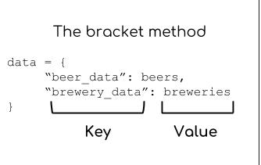
Dictionary Syntax
There are several ways to create a dictionary, but this is the standard and most commonly used syntax.
The dictionary is set off with curly brackets at the front and end; within the brackets are declared key:value pairs in which the colon separates the key from the corresponding value. Each k:v pair is separated by commas.
It is not required but conventional to separate each item on a new line.
Values need not be unique and they can be other objects - including additional dictionaries (dictionaries that contain other dictionaries are often called “nested”).

Slide 10
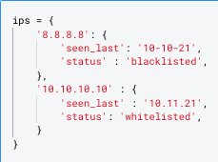
Dictionary Syntax Example

Slide 11
Building a Dictionary in Context
“During my investigation, I started to find the attackers were abusing a lot of infrastructure. They had domains and IPs they were using as hop-points, some for delivering malware, some hosting phishing pages, and others for command and control. I can build a data set with the dates they were used and how and then do additional analysis based on this data….but I need a way to structure this data so I can do analysis of them in code. A bunch of lists isn’t going to cut it because each IOC has multiple properties about it that need to be stored - and if they change on different dates I’d have to keep so many different temporal lists. What can I do?”

Slide 12
Building a Dictionary in Context
“During my investigation, I started to find the attackers were abusing a lot of infrastructure. They had domains and IPs they were using as hop-points, some for delivering malware, some hosting phishing pages, and others for command and control. I can build a data set with the dates they were used and how and then do additional analysis based on this data….but I need a way to structure this data so I can do analysis of them in code. A bunch of lists isn’t going to cut it because each IOC has multiple properties about it that need to be stored - and if they change on different dates I’d have to keep so many different temporal lists. What can I do?”
Unique: the specific domain or IP address
Mutually Exclusive: the type (domain or IP)
Mutually Exclusive: the usage
Unique: the date

Slide 13
Building a Dictionary in Context
Unique: the specific domain or IP address
Mutually Exclusive: the type (domain or IP)
Mutually Exclusive: the usage
Example: identifier as the unique key; values are additional dictionaries with a key: value pair of the date and uses.
Unique: the date
Specific Identifier (e.g. 10.10.10.10)
Date (02-02-21)
Date (02-03-21)
List of uses (e.g. [“hop point”, “c2”])
List of uses (e.g. [‘c2’])

Slide 14
Building a Dictionary in Context
Unique: the specific domain or IP address
Mutually Exclusive: the type (domain or IP)
Mutually Exclusive: the usage
Another orientation: dicts are keyed on use type
Unique: the date
Specific Identifier (e.g. 10.10.10.10)
Type of use: ‘hop point’
Type of use: ‘c2’’
Dates of use as a hop point: [‘02-02-21’]
Dates of use as a c2: [‘02-02-21’, ‘02-03-21’]

Slide 15
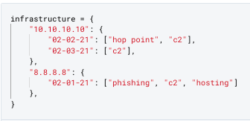
Building a Dictionary in Context
Unique: the specific domain or IP address
Mutually Exclusive: the type (domain or IP)
Mutually Exclusive: the usage
Variable name, if assigning
Open curly brace declares start of the dictionary
Unique: the date
Value pairs can be any type of object.
In this case, another dictionary - find the open brace, key: value pairs!
Specific Identifier (e.g. 10.10.10.10)
Unique key(s)
The inner dictionaries have lists as values
Date (02-02-21)
Date (02-03-21)
List of uses (e.g. [“hop point”, “c2”])
List of uses (e.g. [‘c2’])
Closing brace of the outer dictionary

Slide 16
Building a Dictionary in Context
Unique: the specific domain or IP address
Mutually Exclusive: the type (domain or IP)
Mutually Exclusive: the usage
Unique: the date
There are many possible orientations and which you pick doesn’t matter too much as long as it works for your use case.
What would not work:
Anything where the keys are non-unique.

Slide 17
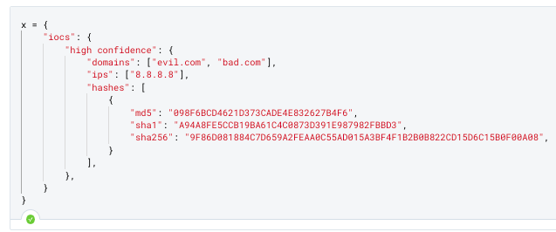
When do you need a dictionary? Examples
“I have a list of IPs that I need to keep track of different data points about - whether we’ve seen in it network traffic over the last 30 days, if it should be blacklisted, etc.”
“I have this report that I need to release IOCs with. I want them structured so other people can consume and use them in code…”

Slide 18
Creating Dictionaries
# create an empty dictionary
x = {}
# create a dictionary of values manually
x = {‘key’:’value’, ‘key2’:’value’}
# convert a compatible object
x = dict([‘key’,’value’], [‘key2’, ‘value’])
x = dict([(‘key’,’value’), (‘key2’, ‘value’)])
# lists can be compatible depending on structure;
# common to see tuples here.
Creation
Addition to / Changes to
Removal From

Slide 19
Modifying Dictionaries
# use slice notation
x[‘key’] = [‘value’]
# use .update() with iterables
x.update([‘key2’, ‘value’])
# mix purpose: get the value of a specific key
# but if that key does not exist, insert the key and the specified value
x.setdefault(‘key3’, ‘default_value’)
Creation
Addition to / Changes to
Removal From

Slide 20
Modifying Dictionaries
# use clear to delete dict contents
x.clear()
# del operator on slice
del x[‘key’]
# pop off the value at the specified key
# nb: returns the popped value
x.pop(‘key’)
# pop off the last key:value pair
# nb: returns the pair
x.popitem()
Creation
Addition to
Removal From

Slide 21
Reading Dictionaries
# gets a value for a given key
x.get(‘key’)
# this has an optional parameter that sets a default value to return if the key does not exist
x.get(‘key’, ‘default’)
# The next set of methods are useful if you need to iterate over dict data
# Get all key:value pairs
x.items()
# Get all the keys
x.keys()
# Get all the values
x.values()
# Get a new dictionary made from specific key:value pairs by naming selected keys
x.fromkeys()
# DO NOT USE THIS SYNTAX
# you will see this but do not do it.
# if you try to get a key that does not exist
# Python will error out.
x[‘key’]
Getting Data from Dicts

Slide 22
Dictionaries & Iteration
Many problems with dictionaries involve accessing and iterating parts of the dictionary. This section contains some example practice problems so you can see what the syntax looks like.

Slide 23
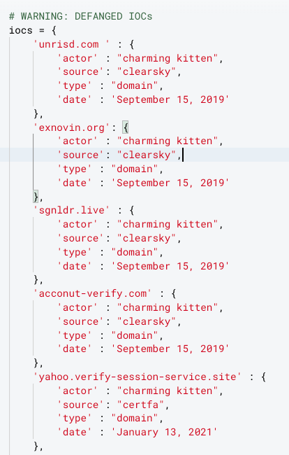
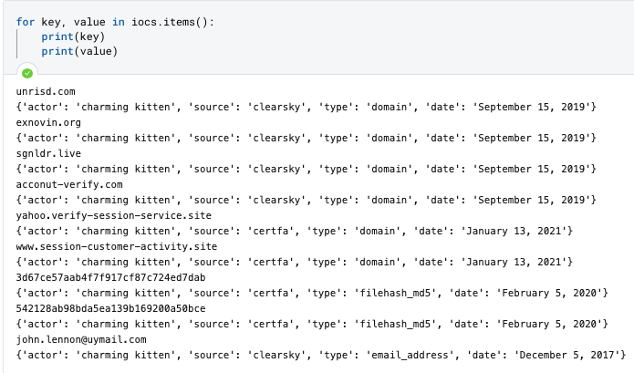
Iterating Dictionaries: getting keys and values with .items()

Slide 24
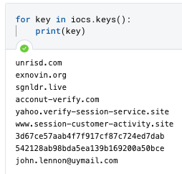
Iterating Dictionaries: getting Keys only

Slide 25
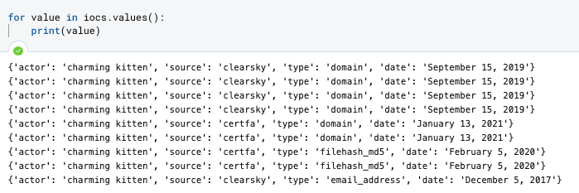
Iterating Dictionaries: getting values only

Slide 26
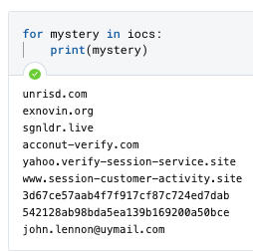
Iterating Dictionaries:
IF YOU DON’t Specify, you get
KEYS ONLY

Slide 27
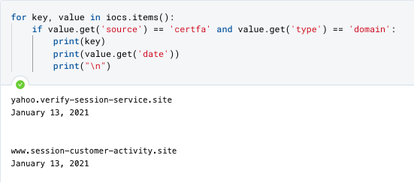
Combine with For loops, lists, conditionals and logical operators for complex classification

Slide 28
JSON
Many third-party APIs will return a structure similar to but not identical to Python’s dictionary called JSON. A few methods to convert between them will help you work with external data sources.

Slide 29
Intro to JSON
JavaScript Object Notation (JSON)
JSON is a data representation format
It is a subset of JavaScript (another programming language) so anything you write in JSON is JavaScript. JavaScript is used all over the internet and so JSON seamlessly integrates with JavaScript.
It is commonly used for structure data which is accessible through APIs and configuration files
It is commonly used because it is lightweight (aka it has a small file size) and is easy to read/write

Slide 30
Programming Vocabulary word: Parsing
Parsing
The way we interpret this word in the programming context is to mean - converting information which is represented in one form into another form (ideally) that’s easier to work with.
For our purposes this will mean taking JSON formatted data and stripping away the formatting which is unique to JSON and converting it into the format which comports with python syntax.

Slide 31
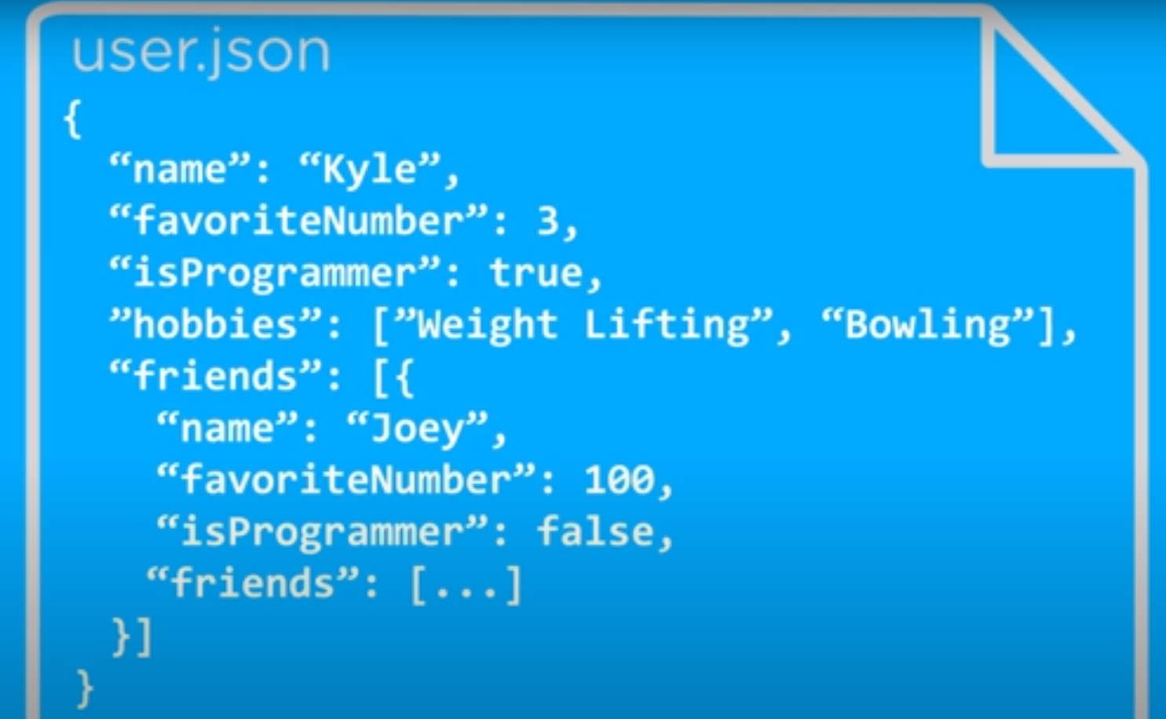
JSON Structure
Structure
The core idea is that you are organizing data into attribute : value pairs.
JSON data is contained within curly brackets { }, each element is an attribute followed by a value, and they are separated by a comma.
Nesting is very common in JSON as JSON data is organized into nested levels.
Note the nested properties.
* Sound familiar? This should look and feel very similar to Python dictionaries!
Notes:
JSON was created to be a universal data format that could be used across all languages and frameworks which means that it has to be quite simple so that it can work with both a Ruby on Rails application and an iOS mobile app.

Slide 32
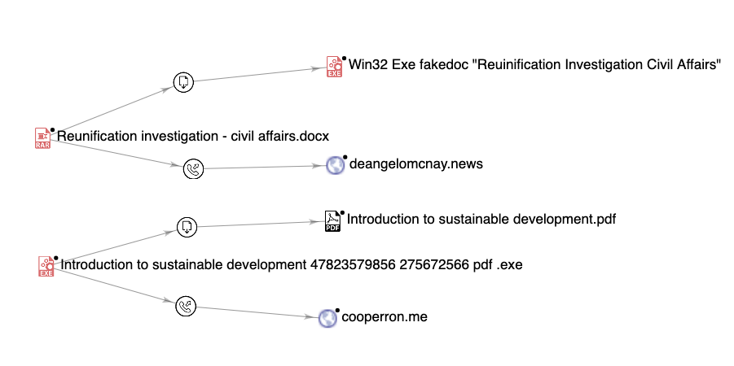
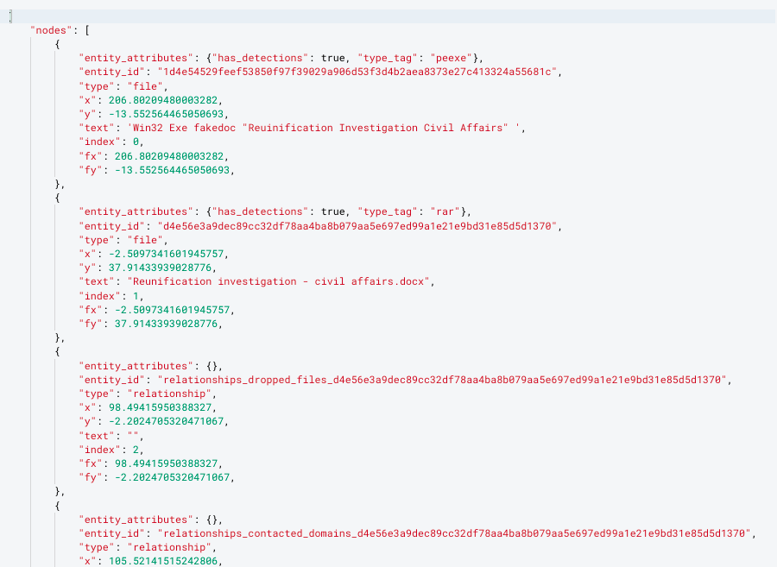
JSON Example (VT)
import json
# to change json string to dict
json.loads(json_str_obj)
# to convert dict to json str
json.dumps(dictionary_obj)
Notes:
If you have a JSON string, you can parse it by using the json.loads() method.
If you have a Python object, you can convert it into a JSON string by using the json.dumps() method.

Slide 33
DictionarY Partners & lookalikes
Tuples and Sets

Slide 34
What’s a compatible object?
New Data Type: tuples
Tuples are ordered, like lists, but they are distinctive in that the contents of a tuple can never be changed after they are assigned. While it is common for tuples to come in pairs, they can be of any length or even empty. They are iterable. They are commonly used to create dictionaries or when scraping dictionary contents to a new structure because they can forcibly pair keys and values.
The property tuples have of being unchangeable is called immutability. Most of the data types we’ve learned about so far (integers, floats, strings, bools) are all immutable data types. The collections we’ve learned about so far - lists and dictionaries - are mutable. Tuples are a collection like lists or dictionaries but they are immutable.
Tuples are declared using a list of comma separated values with no square brackets around them. By convention, it is common to see parentheses used instead but this is not required.
x = 1, 2
x = ‘a’, ‘b’, ‘c’
x = (1, 2)
Note: don’t confuse a tuple with multiple variable assignment in the same statement.
x, y = 1, 2
This is two variables and not a tuple.

Slide 35
Potential Source of Confusion
New Data Type: Sets
Some of the most valuable set comparison methods:
set.union()
set.difference()
set.intersection()
set.isdisjoint()
set.issubset()
Other set methods to know (these work like other similar methods for other data types we have covered previously):
set.clear()
set.pop()
set.update()
set.add()
Sets are collections, like lists or tuples, but sets can only contain one of each value. They are mutable and unordered (so you cannot slice them). Sets are declared as a sequence of values between curly braces (or by explicitly declaring them with the set() keyword around a comma-separated tuple). Rather than being often used with dictionaries, they are often easily confused for them because they also use curly braces.
x = {1, 2, 3} # set, not a dictionary - no k, v pair
x = set(1, 2, 3) # set conversion from tuple
Sets are valuable for de-duplicating values (since they can only contain one of each value) and they have various methods for logic that are very helpful for solving problems.

Slide 36
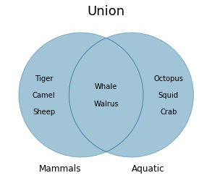
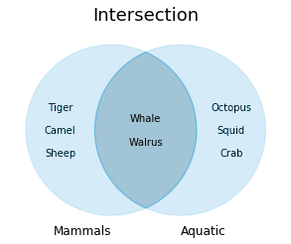
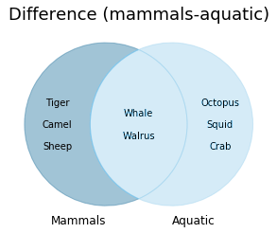
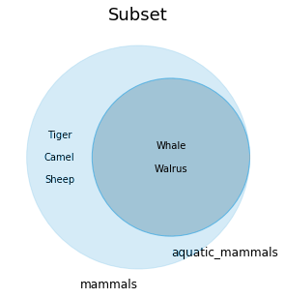
Potential Source of Confusion
New Data Type: Sets
Some of the most valuable set comparison methods:
set.union()
set.difference()
set.intersection()
set.isdisjoint()
set.issubset()
Go read about set theory and implementation in Python

Slide 37
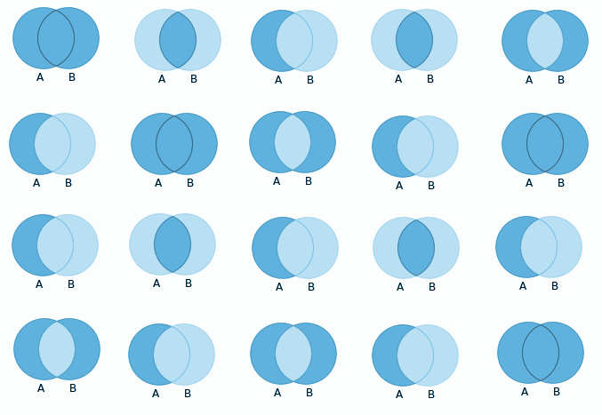
Potential Source of Confusion
New Data Type: Sets
Some of the most valuable set comparison methods:
set.union()
set.difference()
set.intersection()
set.isdisjoint()
set.issubset()
Go read about set theory and implementation in Python

Slide 38
When do I use sets?
Dedupe
Relationships between Sets of Objects

Slide 39
Data Types to date
Type | Examples | Properties / Description
Name: Integer (“int”) Code to convert: int(x) Mutable: no | -1 0 1 | Integer whole numbers that you can use in mathematical operations
Name: Floating Point (“float”) Code to convert: float(x) Mutable: no | -1.0 0.0 1.0 | Decimal-point precision real numbers that you can use in mathematical operations
Name: Boolean (“Bool”) Code to convert: bool() Mutable: no | True False | Data type that can only be True or False. Conditions exist to convert objects into True or False values.
Name: String Code to convert: str(x) Mutable: no | “Example” “1.0” | Ordered sequence of text characters, cannot be used in mathematical operations
Name: List Code to convert: list() Mutable: yes | [1, 2, 3] [“one”, 2, False] | Ordered sequence of Python objects of any type
Name: Tuple Code to convert: tuple() Mutable: no | 1, 2, 3, 4 (1, 2, 3, 4) # convention only | Ordered, immutable sequence of objects
Name: Set Code to convert: set() Mutable: yes | {1, 2, 3} set(1, 2, 3) | Unordered mutable sequence of objects that can only contain one of each object. Many methods for manipulating objects using set theory. Useful for deduplication and comparison tasks by creating more than one set.
Name: Dictionary (“dict”) Code to convert: dict() Mutable: Yes | {‘key’:’value’, ‘another key’:’value’} | Unordered collection that contains key:value pairs in which the keys must all be unique

Slide 40
Infosec Topic
Introduction to Malware,
Introduction to Working with Graphs,
Introduction to VirusTotal

Slide 41

What is Malware?
Malware: code designed to disrupt, disable, take control of, or co-opt a computing system.
* But also malware can take many different forms so aligning on any one definition is tricky.
Malware works by taking advantage of vulnerabilities in your hardware, operating system, or software.
Notes:
[Lauren] Malware is a portmanteau of the terms “malicious” and “software.” Malware can take many different forms and thus has many different definitions. Typically we think of malware as code which was designed to disrupt, disable, take control of, or co-opt a computing system. Software is identified as malware based on its intended use. An important note which we will come back to in a few slides is that it should not matter if the user has technically consented to a specific action (e.g. accessing their data) but rather whether or not how the data will be used is clearly declared.
The way malware works at its most basic is that a technology or user interacts with code in some way which has been designed to identify vulnerabilities on the system (could be at any level across hardware, the operating system, or software on the device) and to exploit those vulnerabilities. It is important to understand that if a system is operating with no vulnerabilities then it will not be vulnerable to malware. We are going to do a class on vulnerabilities in a couple of weeks which will help to spell this out in more detail but know that vulnerabilities and malware are intrinsically linked.

Slide 42
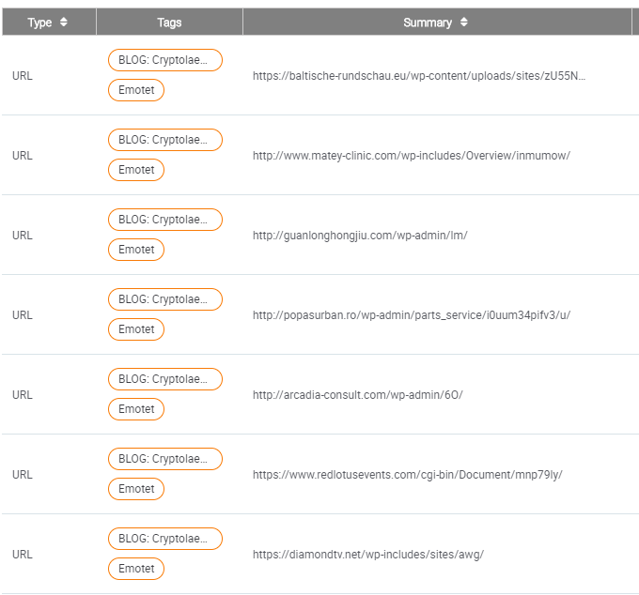
How do people interact with malware?
1
Links
Files
Zero-click Exploitation
2
3
Notes:
[Lauren] Malware can make entry onto your computer via file downloads, visiting infected websites, or through interactions with links or attachments.
A common misunderstanding within companies is that malware is only spread via attachments. This is not true. Links can also be used to spread malware.
That said files are particularly concerning. Common methods of interacting with malicious files is through Word Documents, Excel Files, and PDFs which can all contain malicious executables.
Applications, like the ones you install on your phone, can themselves be malicious. Let’s say you got a malicious app onto the App Store then lots of people would install it and be none the wiser.
Zero-click exploitation is rarer and the vulnerabilities that can be exploited this way are highly sought after and therefore less likely to be used on the general public. The idea here is that something could happen like you open a text and bam you are infected without having had to click on anything within the text. Any system that receives data before determining whether that delivery is trustworthy can suffer an interactionless attack.

Slide 43
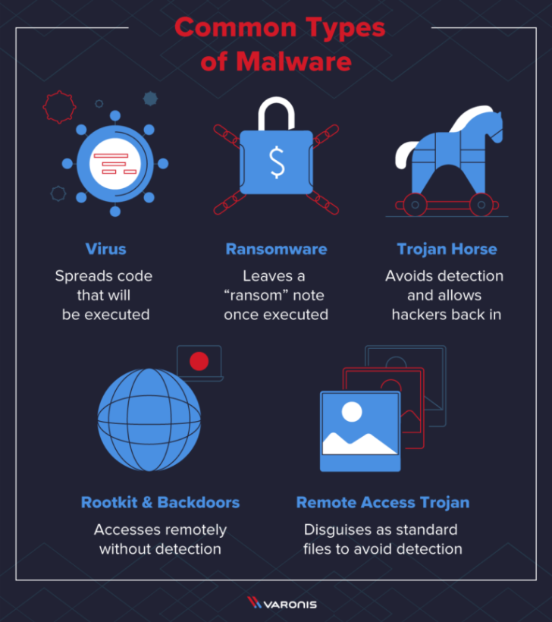
Types of Malware
Notes:
[Lauren] There are quite a few different types of malware and when you describe the TTPs of a given attack it can be helpful and important to describe the type of malware used. Some common terms are worm, virus, trojan, rootkit, backdoor, RAT, and ransomware.
A worm is standalone software which can replicate itself and infect multiple computers on a network. Network worms often use computer networks to spread, slowing down traffic and relying on security failures (such as outdated operating systems and lack of AV) to spread. While viruses require the spreading of a file, worms are a standalone software and do not require a host or human help to spread.
A virus is typically attached to an executable file which means that it might exist on a system but will not spread until a user opens the infected program. Viruses often originate on the internet and spread when downloading a file infected with a virus. Peer to peer file sharing and email attachments are other common methods through which viruses are spread.
A Botnet is a network of infected computers. There is a master computer which is infecting zombie computers. Then it can distribute its activity across all of the zombie computers. This is particularly important when you need a lot of traffic for your attack such as in a DDOS.
A trojan is a program that cannot reproduce itself but masquerades as something the user wants and tricks them into activating it so it can do its damage and spread.
Spyware typically rests on a system and collects information about the user and relays that back to the operator of the spyware. Adware is a type of spyware which relays this info back to an advertiser.
A rootkit is "a program or, more often, a collection of software tools that gives a threat actor remote access to and control over a computer or other system." (TechTarget) It gets its name because it's a kit of tools that (generally illicitly) gain root access (administrator-level control, in Unix terms) over the target system, and use that power to hide their presence.
Remote Access Trojans or RATs—essentially, rootkits that propagate like Trojans.
Ransomware is a flavor of malware that encrypts your hard drive's files and demands a payment, usually in Bitcoin, in exchange for the decryption key.
Backdoors are installed on a system by an attacker so that they can circumvent security measures to have persistent access to the system.

Slide 44
Grayware aka PUPs
Grayware aka Potentially Unwanted Programs (PUPS)
Malicious software or code that is considered to fall in the "grey area" between normal software and malware.
This could be software that a user intentionally installed and which does perform the function the user was hoping it would but it is also taking some adverse action against the user without their awareness.
Stalkerware fits into this category
Types of data a device can get access to:
GPS location
Pictures taken with front/rear camera (unbeknownst to user)
SMS messages
Call history
Browser history
Recorded audio via device mic
Email accounts stored on device
Phone numbers in contact list
IP address of device
Notes:
[Lauren] Because intent is a core component of how we understand what is “malicious” there are many programs which fall in the "grey area" between normal software and malware. These may be called grayware or potentially unwanted programs (PUPS). This could be software that a user intentionally installed and which does perform the function the user was hoping it would but it is also taking some adverse action against the user without their awareness. Stalkerware fits into this category. Spyware may be used by cybercriminals to target high-profile lawyers, politicians, celebrities, or other positions of power, but is also used by normal people who may think their action is benign such as monitoring a child’s phone usage or by those with harmful intent such as those who commit acts of domestic violence or intimidation. These companies are not hiding their products. Companies like mSpy, PhoneSheriff, MobiStealth, and StealthGenie all market their stalkerware.
All of these companies have apps can be run on an Android device in the background, with users none-the-wiser. Some of these apps’ features include the ability to:
Access calendars and address books
Control apps on the user’s device
Monitor call logs
Monitor conversations through popular communication apps like Skype
Monitor instant messages
Monitor keystrokes
Monitor SMS conversations
Monitor web history
Read emails
Record anything within the distance of the device’s microphone
Record calls
Remote control the device
Track the device using GPS

Slide 45
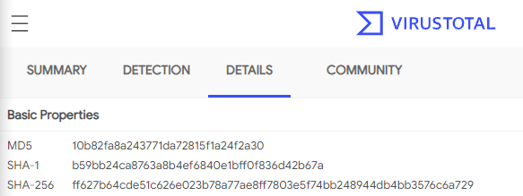
Hashes
A hash is a unique identifier of a file.
Common hashing algorithms used for malware hashing:
MD5
SHA-1
SHA-256
Notes:
Malware hashing is the process of generating cryptographic hashes for the file content of the target malware. Hashes are unique identifiers of a given file.
There are lots of different ways to encrypt something and different encryption schemes have different names. For example, a really basic one is called a caesar cipher. This is a method through which you replace each character with a different one a fixed number of places away in the alphabet. This is a really basic type of cipher but cryptography is a really complex field with many different ciphers and the common hashing algorithms used for malware identification are: - MD5
- SHA-1
- SHA-256
Why do we represent a given file with multiple different hashes?
The Message-Digest Algorithm 5 (MD5) hash function is the one most commonly used for malware analysis. It produces a 128-bit hash value. Although MD5 is historically very popular in malware research, it is vulnerable to collision attacks, meaning two different inputs may have the same hash.
The Secure Hash Algorithm (SHA) is also used in malware research. The SHA1 algorithm is also vulnerable to the collision attack. In malware research, SHA-256 is becoming the most popular although MD5 is still used.
SHA-2 (Secure Hash Algorithm 2) is a set of cryptographic hash function including SHA-224, SHA-256, etc. SHA256 generates a 256-bit hash and is more reliable then SHA1 or MD5s.

Slide 46
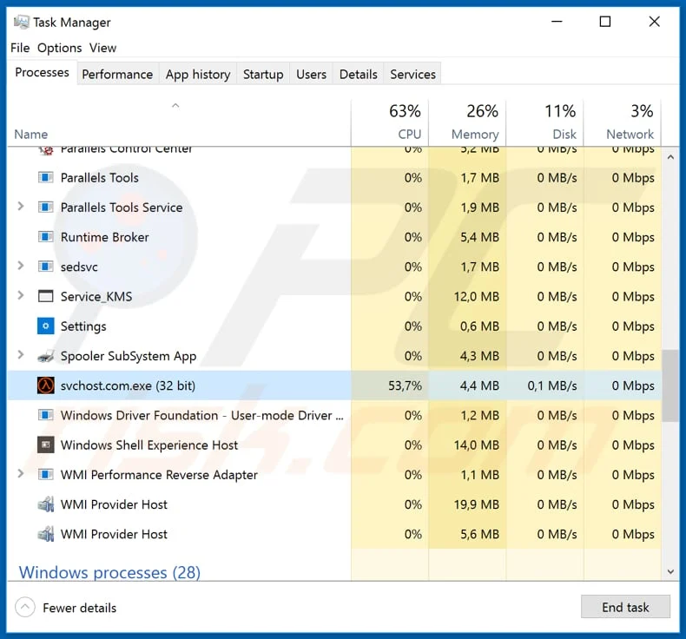
Hashes
Two files can have the same name and contain completely different content. Therefore, names are a low fidelity IOC.
Hashes on the other hand are unique and so are a much higher fidelity IOC.
Notes:
It is important to use hashes to identify malware because they are unique which is much more effective then using a file name to identify a given piece of malware because as we can all imagine just like how you could have word document whose content is on any different topic and you could still name it “MyDoc[.]doc” similarly you could create a rootkit and name it “MyNiceProgram” or a totally different type of malware like ransomware and name it “MyNiceProgram.”
I want to drive home this point about uniqueness. Let’s say you have two identical files of code and then you change one line of code in one file and not in the other and then hash them. These will have two distinct hashes. You can imagine then that this is very helpful for tracking malware as it evolves and is modified by an attacker.
Malware hashes are used to identify malware on malware analysis sites (VirusTotal) and in threat reporting as you have all noticed during the homework.

Slide 47
Malware Analysis
High-level Overview

Slide 48
Common Goals of MAlware Analysis
Attribution
Incident response
infrastructure
Identification & Classification
Behavior
Finding clues as to who wrote the file, why, and who might have received it.
Understanding what a file does and what might have been impacted or taken in an incident.
Finding other aspects of the attacker’s infrastructure - like domains or IPs they used for exfiltrating data
Writing signatures in an engine (like clamav or YARA) to help identify similar malicious files
Understanding the full capabilities of a file, including those you didn’t see happen in an incident
Notes:
Malware analysis is the process of analyzing a malware sample and extracting as much information as possible from it. The information we extract helps us understand the scope of the functionality of the malware, how the system was infected with the malware, and we can learn from this how to defend against similar attacks in the future.
Malware analysis can inform attribution as we find clues as to who wrote the file, what their intent was, and based on intent who might have received it.
Since malware analysis is a technical endeavor along the way the analyst is likely to find other aspects of the attacker’s infrastructure such as domains and IPs they used for exfiltrating data which can then be tracked as IOCs related to a case.
Finally, if we want to protect an organization from malware we have to understand what we are protecting against. One common method of protecting against malware is for an organization to implement rules which basically match on the characteristics of malicious content and take some action such as alerting an incident responder or blocking the activity. Rules can also be called signatures and common security signature types include ClamAV and YARA. In order to write an appropriate signature you need to know exactly what you are going to define as malicious or you will write a bad rule with low fidelity. Malware analysis helps you understand how to write the rule.

Slide 49
Common Techniques
Dynamic Analysis
Static Analysis
Running a file and seeing what it does
Examining a file’s contents and trying to interpret what it can do
Notes:
Static analysis is the process of anlayzing malware without executing or running it. The objective is to extract as much metadata from the malware as possible. For example you might extract unique strings or IP addresses from the malware.
Dynamic analysis is the process of executing malware and analyzing it’s functionality and behaviour. The objective is to understand exactly how and what the malware does during the execution.

Slide 50
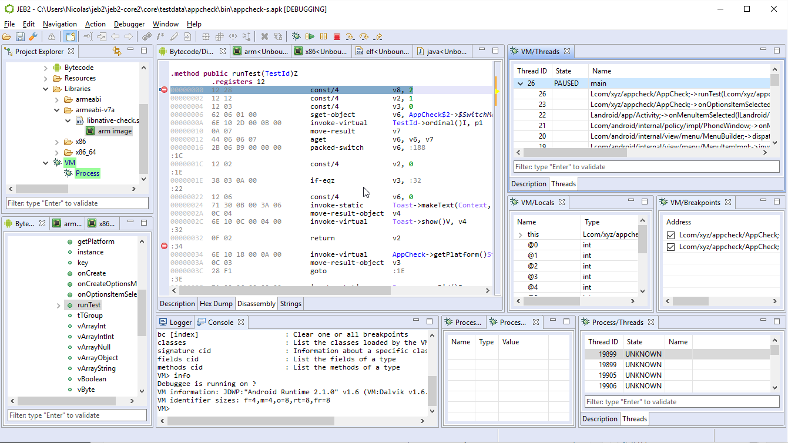
Dynamic Analysis / Behavioral Analysis
In dynamic analysis, a file is placed in a test environment - oftentimes a virtual machine, and the file is executed. The analyst may use a tool called a debugger to step through execution and keep track of variables in memory and the state of the program.
The analyst will try to understand what the malware is accomplishing by watching how it changes the host computer.
Notes:
In dynamic analysis, a file is placed in a test environment - oftentimes a virtual machine, and the file is executed. The analyst may use a tool called a debugger to step through execution and keep track of variables in memory and the state of the program.
The analyst will try to understand what the malware is accomplishing by watching how it changes the host computer.

Slide 51
Dynamic Analysis
Advantages:
When you execute a file dynamically, you can sometimes quickly see how the file appears to the end user (does it have a lure?), you may be able to quickly capture network traffic (say with a network capture tool like wireshark), and you can potentially bypass tricks adversaries will use to fool someone trying to use a different technique to introspect the code. It’s often easier and more accessible to beginners and requires less intricate understanding of how computer systems operate.
Disadvantages:
Attackers may put in place measures to understand when they are in a VM and change behavior. They may have a fake C2 or not execute. You can also miss alternative behaviors the file might use if your environment were different. You also have to be able to maintain a safe and convincing environment.
Notes:
Advantages:
When you execute a file dynamically, you can sometimes quickly see how the file appears to the end user (does it have a lure?), you may be able to quickly capture network traffic (say with a network capture tool like wireshark), and you can potentially bypass tricks adversaries will use to fool someone trying to use a different technique to introspect the code. It’s often easier and more accessible to beginners and requires less intricate understanding of how computer systems operate.
Disadvantages:
Attackers may put in place measures to understand when they are in a VM and change behavior. They may have a fake C2 or not execute. You can also miss alternative behaviors the file might use if your environment were different. You also have to be able to maintain a safe and convincing environment.

Slide 52
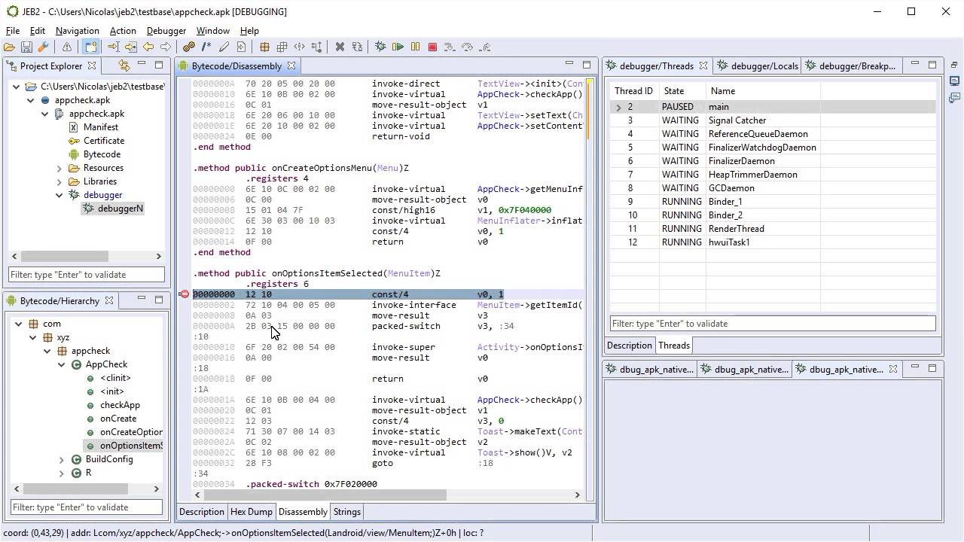
Static Analysis / Reversing
In static analysis a file is not executed. Instead, the analyst uses various tools - oftentimes a decompiler or a disassembler to examine the malicious application.
Reversing is an entire career path and can be quite difficult and detail-oriented. But some programs are easier to take apart and may be more accessible for beginners.
Notes:
In static analysis a file is not executed. Instead, the analyst uses various tools - oftentimes a decompiler or a disassembler to examine the malicious application.
Reversing is an entire career path and can be quite difficult and detail-oriented. But some programs are easier to take apart and may be more accessible for beginners.

Slide 53
Static Analysis
Advantages:
When you look at a file statically, you don’t have to set up a safe test environment or worry about results of code execution. You can explore many different execution paths a file might take. You may be able to more easily identify components of the file that are unique and could make for good YARA signatures.
Disadvantages:
Attackers may design intentional traps for you, like creating forks of code that will never be followed. They may obfuscate parts of their code quite heavily and make extracting meaningful findings difficult.
Notes:
Advantages:
When you look at a file statically, you don’t have to set up a safe test environment or worry about results of code execution. You can explore many different execution paths a file might take. You may be able to more easily identify components of the file that are unique and could make for good YARA signatures.
Disadvantages:
Attackers may design intentional traps for you, like creating forks of code that will never be followed. They may obfuscate parts of their code quite heavily and make extracting meaningful findings difficult.

Slide 54
For this class
You do not need to analyze malware for this class; however, you will interact with malware hashes.
If you want to learn, talk to us and we can discuss project ideas that involve Python or Android malware but I only recommend this if you are incredibly dedicated and passionate about it. For everyone else:
DO NOT DOWNLOAD MALWARE. ONLY INTERACT WITH HASHES.
You will be using data in VirusTotal, some of which is derived from static and dynamic analysis. There are also other online engines and reports you will likely find and can use from open-source.

Slide 55
Intro to Graph Theory
Working with Nodes & Edges
Notes:
This week we will be introducing you to graph theory because it will help you to navigate VirusTotal.

Slide 56
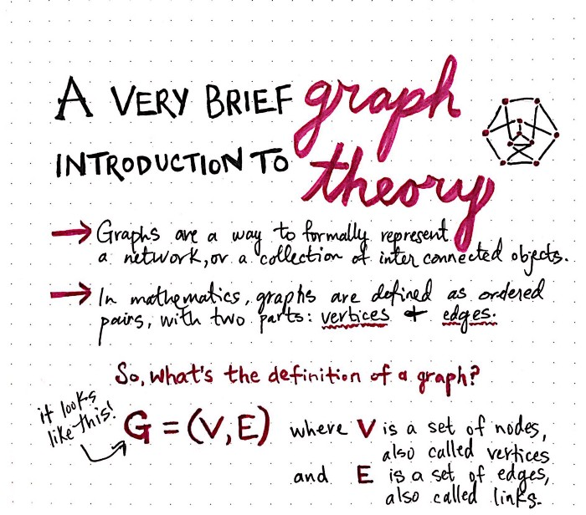
Great introduction to the topic is here. We’ll use a lot of graphics from this tutorial.

Slide 57
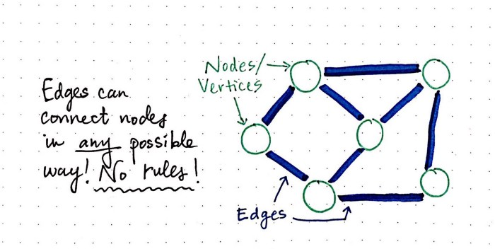
Intro to Graph Concepts
Graphs represent objects, their relationships, and various aspects about both.
Objects are represented by nodes (sometimes called vertices) - often a circle or other shape - and the relationships between those objects are represented with lines called edges.
Both nodes and edges can have properties (such as a name or other information about the node or edge).
Notes:
Graphs represent objects, their relationships, and various aspects about both.
Objects are represented by nodes (sometimes called vertices) - often a circle or other shape - and the relationships between those objects are represented with lines called edges.
Both nodes and edges can have properties (such as a name or other information about the node or edge).

Slide 58
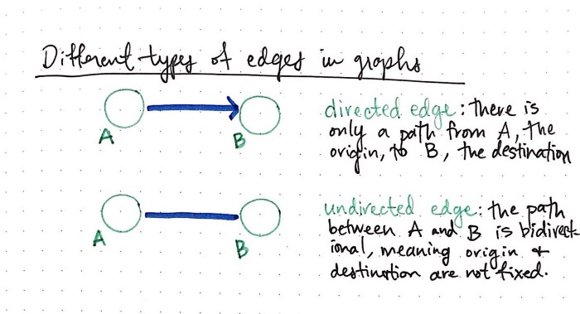
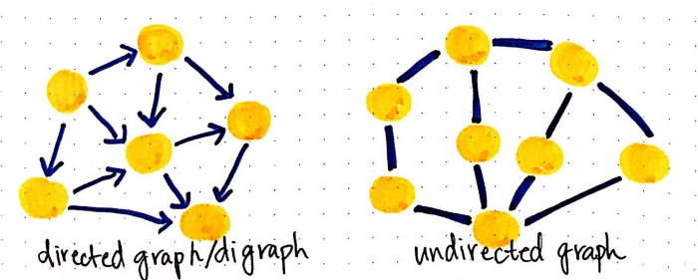
Directionality
Graph edges can have direction; this implies a relationship between two objects can be one way (ex. “Parent” vs “child”) or may be bidirectional (“cousin”).
Edges that have a forced direction are often depicted with arrows.
Edges are thereofore often classified as directed or undirected.
Notes:
Graph edges can have direction; this implies a relationship between two objects can be one way (ex. “Parent” vs “child”) or may be bidirectional (“cousin”).
Edges that have a forced direction are often depicted with arrows.
Edges are thereofore often classified as directed or undirected.

Slide 59
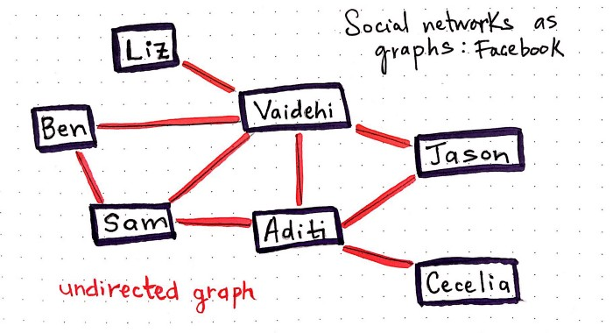
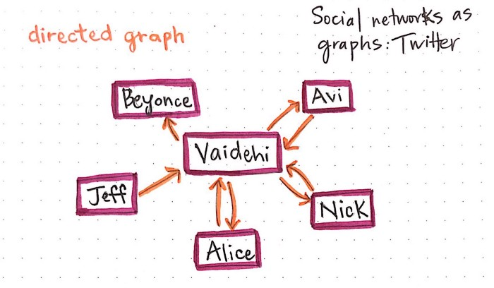
Examples

Slide 60
Directionality
When it comes to the security space, most investigations are represented with graphs.
Relationships between malware and infrastructure are particularly commonly represented in this way.
File
IP
Domain
Calls out to
Hosts
Notes:
When it comes to the security space, most investigations are represented with graphs.
Relationships between malware and infrastructure are particularly commonly represented in this way.

Slide 61
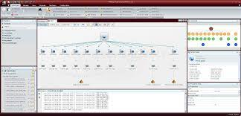
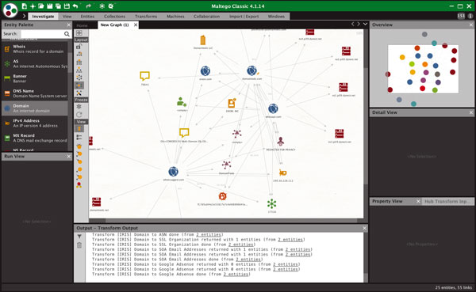
Maltego
Notes:
There are plenty of graphing products which are used in the security space but one of the most common is a tool called Maltego. We will not be using this tool in this class but if this is of particular interest to you you may want to checkout some demos online.
Other graph analysis tools which you may have heard of include Palantir which is proprietary and usually only used at organizations, such as the government, with significant datasets.
Finally, VirusTotal has its own graph analysis GUI!

Slide 62
Graph Exercise
“Our client received two separate emails from the same sender (badguy@evil.com). The first contained a link (evil.com/bad) that directed them to download a file that investigators determined to be malicious (10b82fa8a243771da72815f1a24f2a30). The second email contained the same exact file as an attachment. The file in each instance had the same C2 domain (bad.com). At the time of the first email, this domain resolved to one IP address (256.256.256.256); at the time of the second, it resolved to another (0.0.0.0). Both IPs were obtained from the same bullet-proof hoster (“bullethost”), and also hosted a known phishing domain we believe to have been used by the same campaign (phishy.com).”

Slide 63
Graph Exercise
“Our client received two separate emails from badguy@evil.com. The first contained a link (evil.com/bad) that directed them to download a file that investigators determined to be malicious (10b82fa8a243771da72815f1a24f2a30). The second email contained the same exact file as an attachment. The file in each instance had the same C2 domain - bad.com. At the time of the first email, this domain resolved to 255.255.255.255; at the time of the second, it resolved to 0.0.0.0. Both IPs were obtained from the same bullet-proof hoster (a company named “bullethost”), and also hosted a known phishing domain we believe to have been used by the same campaign (phishy.com).”
Nodes:
badguy@evil.com (email address)
evil.com (domain)
evil.com/bad (url)
10b82fa8a243771da72815f1a24f2a30 (file hash)
bad.com (domain)
255.255.255.255 (ip address)
0.0.0.0 (ip address)
Bullethost (hosting service)
Phishy.com (domain)

Slide 64
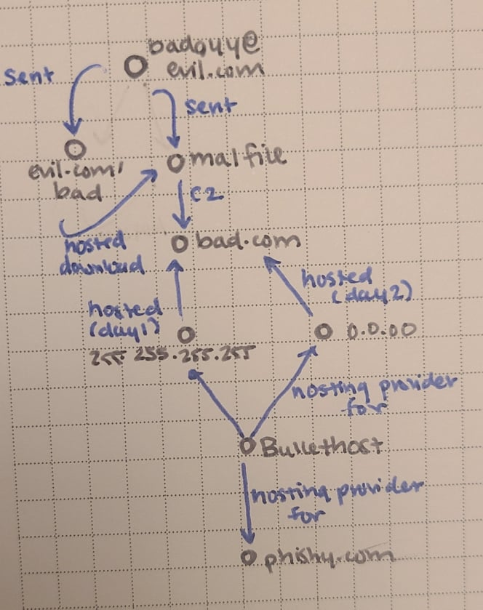
Graph Exercise
“Our client received two separate emails from badguy@evil.com. The first contained a link (evil.com/bad) that directed them to download a file that investigators determined to be malicious (10b82fa8a243771da72815f1a24f2a30). The second email contained the same exact file as an attachment. The file in each instance had the same C2 domain - bad.com. At the time of the first email, this domain resolved to 255.255.255.255; at the time of the second, it resolved to 0.0.0.0. Both IPs were obtained from the same bullet-proof hoster (a company named “bullethost”), and also hosted a known phishing domain we believe to have been used by the same campaign (phishy.com).”

Slide 65
VT Exercise
Sign up for an account with your Georgetown email address (emails sent out)
Create a new graph (https://www.virustotal.com/graph/)
Try to discover anything interesting that you can about a file. You may pick one of your choice that’s in VT or use an example:
1d4e54529feef53850f97f39029a906d53f3d4b2aea8373e27c413324a55681c
8a730266c62fa79435497b1d7db38011e63b6c53b48593d65c24c36044d92dba
Common Malware Pivots:
Command and Control (C2, C&C, CC) infrastructure: where a file reaches out to for instructions or to exfil information.
PDB strings: debug related strings that may point to a common author
PE file import hashes
YARA Rules (string-based pattern matching)

Slide 66
Intro to VirusTotal GraPh Example

